Slide 1

City of Casey Innovation Crowd
Cyber Security
15 Sep 2021

Slide 2
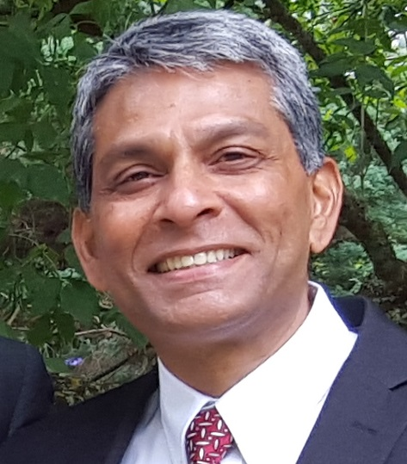
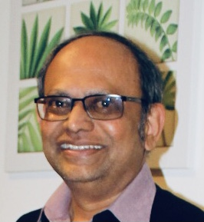
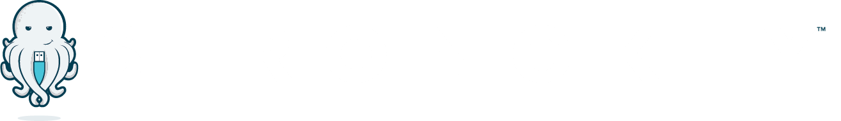


Keylogix Pty Ltd
Nayaz Noor
Director Business Development
Jay Kunnangath
Director – Strategic Partnerships

Slide 3
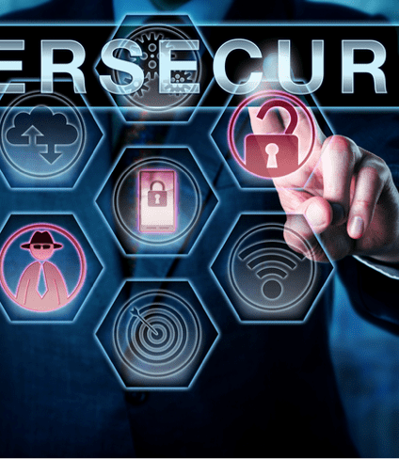
Topics covered
Cybersecurity – What is it?
Cybersecurity Awareness – Why is it important? Short video
What do we store in our systems
Some statistics in brief
What is Phishing, SMiShing, Vishing- BEC etc – short video
What to look out for when being scammed
Precautions to take
Remedies, passwords, internet safety
Useful Cyber Security websites –Phishing Quiz/Assessments
Australian Essential Eight – Defence against Cyber Threats - ACSC
Reporting Cybercrime – Infographic
Q & A if any
Notes:
A brief idea to the participants what we will be covering today

Slide 4
What is Cyber Security?
Cyber security is the practice of defending Assets and reducing risks of Cyber Attacks from malicious actors.
Assets - Computers & Servers, Mobile Devices, Electronic systems, Computer Networks, Programs, Databases and Data
Notes:
Description of CS covering the assets of the various industry, data bases, e-commerce sites etc

Slide 5
The Core principles of Cyber Security
Confidentiality – Protecting private and sensitive information ( Authorized users only to access)
Integrity – Protecting Data from deletion or modifications (either deliberately or accidentally)
Availability – Actual availability of Data when required, to the authorized user
Accountability – Held accountable for the above. (No entity to deny changes made)
Notes:
To let viewers know why the CIA Triad is important. Give examples of Hotels, banks etc

Slide 6
Why is cybersecurity awareness important in any industry?
Digital Transformation of organizations:
Online Transactions - retail
Connected devices – Explosion of IoT
Digital payment technology
Cloud data integration
Customer Data Analytics
Regulatory compliance – OAIC/GDPR/PSD2
Employees are the strongest/weakest links to keep organizations secure
Notes:
Let’s get started...precursor to the video

Slide 7

Cyber Security 101
Notes:
Video – 3minutes – Courtesy NOVA PBS

Slide 8
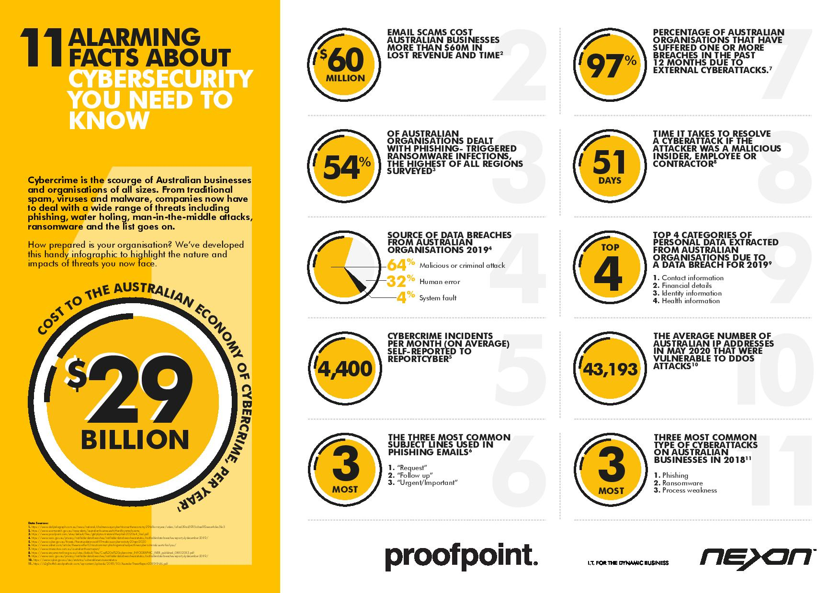
Money
Time
Data
Notes:
95% of CS breaches caused by Human error ( Cybint)

Slide 9
What do we store in our systems ? Personal Data
Legal names and Dates of Birth
Personally Identifiable Information – Law, Health
Bank details – Real Estate, Conveyancers
We keep CC details of our clients – long periods – Tourism and Hospitality, retail
We use online services to pay for our purchases, months prior to delivery of services
We correspond with our customers by email exchanging PII
Emails – archive
DATA!
Notes:
Information is an indispensable component of conducing business and In a growing number of companies, Information IS their business. And therefore it is important we protect it.

Slide 10
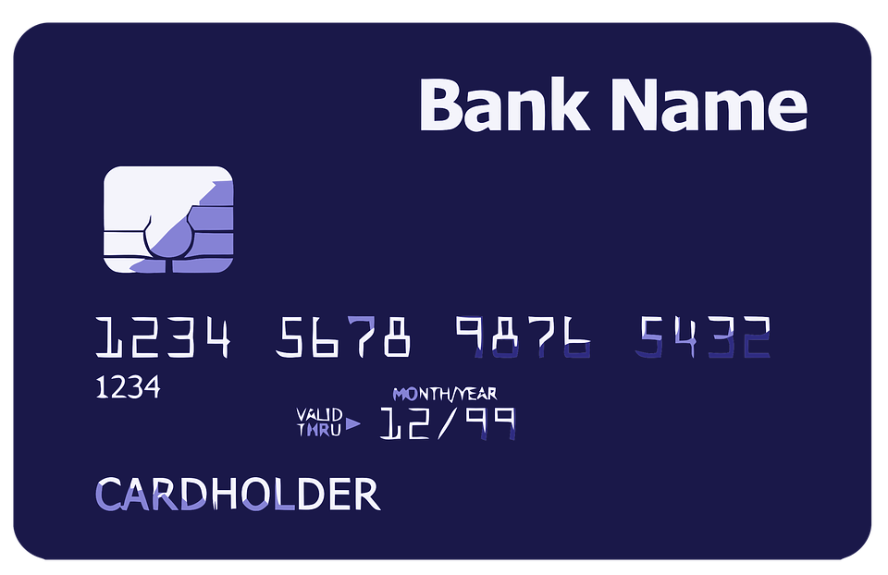


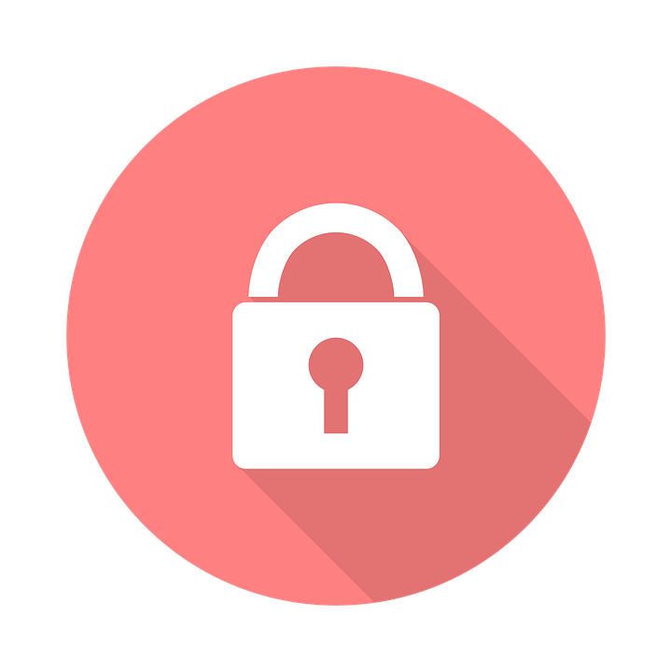
But an attacker is not interested in me....
Wrong!!! You are exactly what an attacker wants!
Credit card and financial data
Medical data
Personal information
Phishing Emails,
Malicious actors reserving their
Cyber Attacks through Social Engineering.
Notes:
The bottom line is that everyone has something that an attacker wants. With data, it could be financial, personal, or even medical related. This is also a good time to ask if everyone knows what ransomware is. A go-to analogy is comparing it to a Hollywood kidnapping movie where the criminals ask for a ransom to get the person back. Ransomware is similar, except it is keeping you from accessing your data unless you pay the ransom.

Slide 11
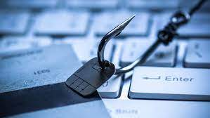
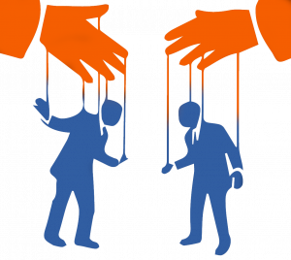
Social Engineering – One of several Threats besides Malware, Ransomware etc
Phishing - Tops all others
SMS – Smishing
VMS – Vishing ( voice)
Shoulder Surfing
Tailgating
Business Email Compromise – most common
Notes:
Other than Ransomware, DoS, DDoS, MITM, Password Attacks, Brute Force Attack, DNS Spoofing etc
95% of CS breaches caused by human error ( Cybint)
$17700 lost every minute to Phishing
164 Cyber crimes every day in australia ( 1 in 8-10minutes)
Talking of emails -

Slide 12
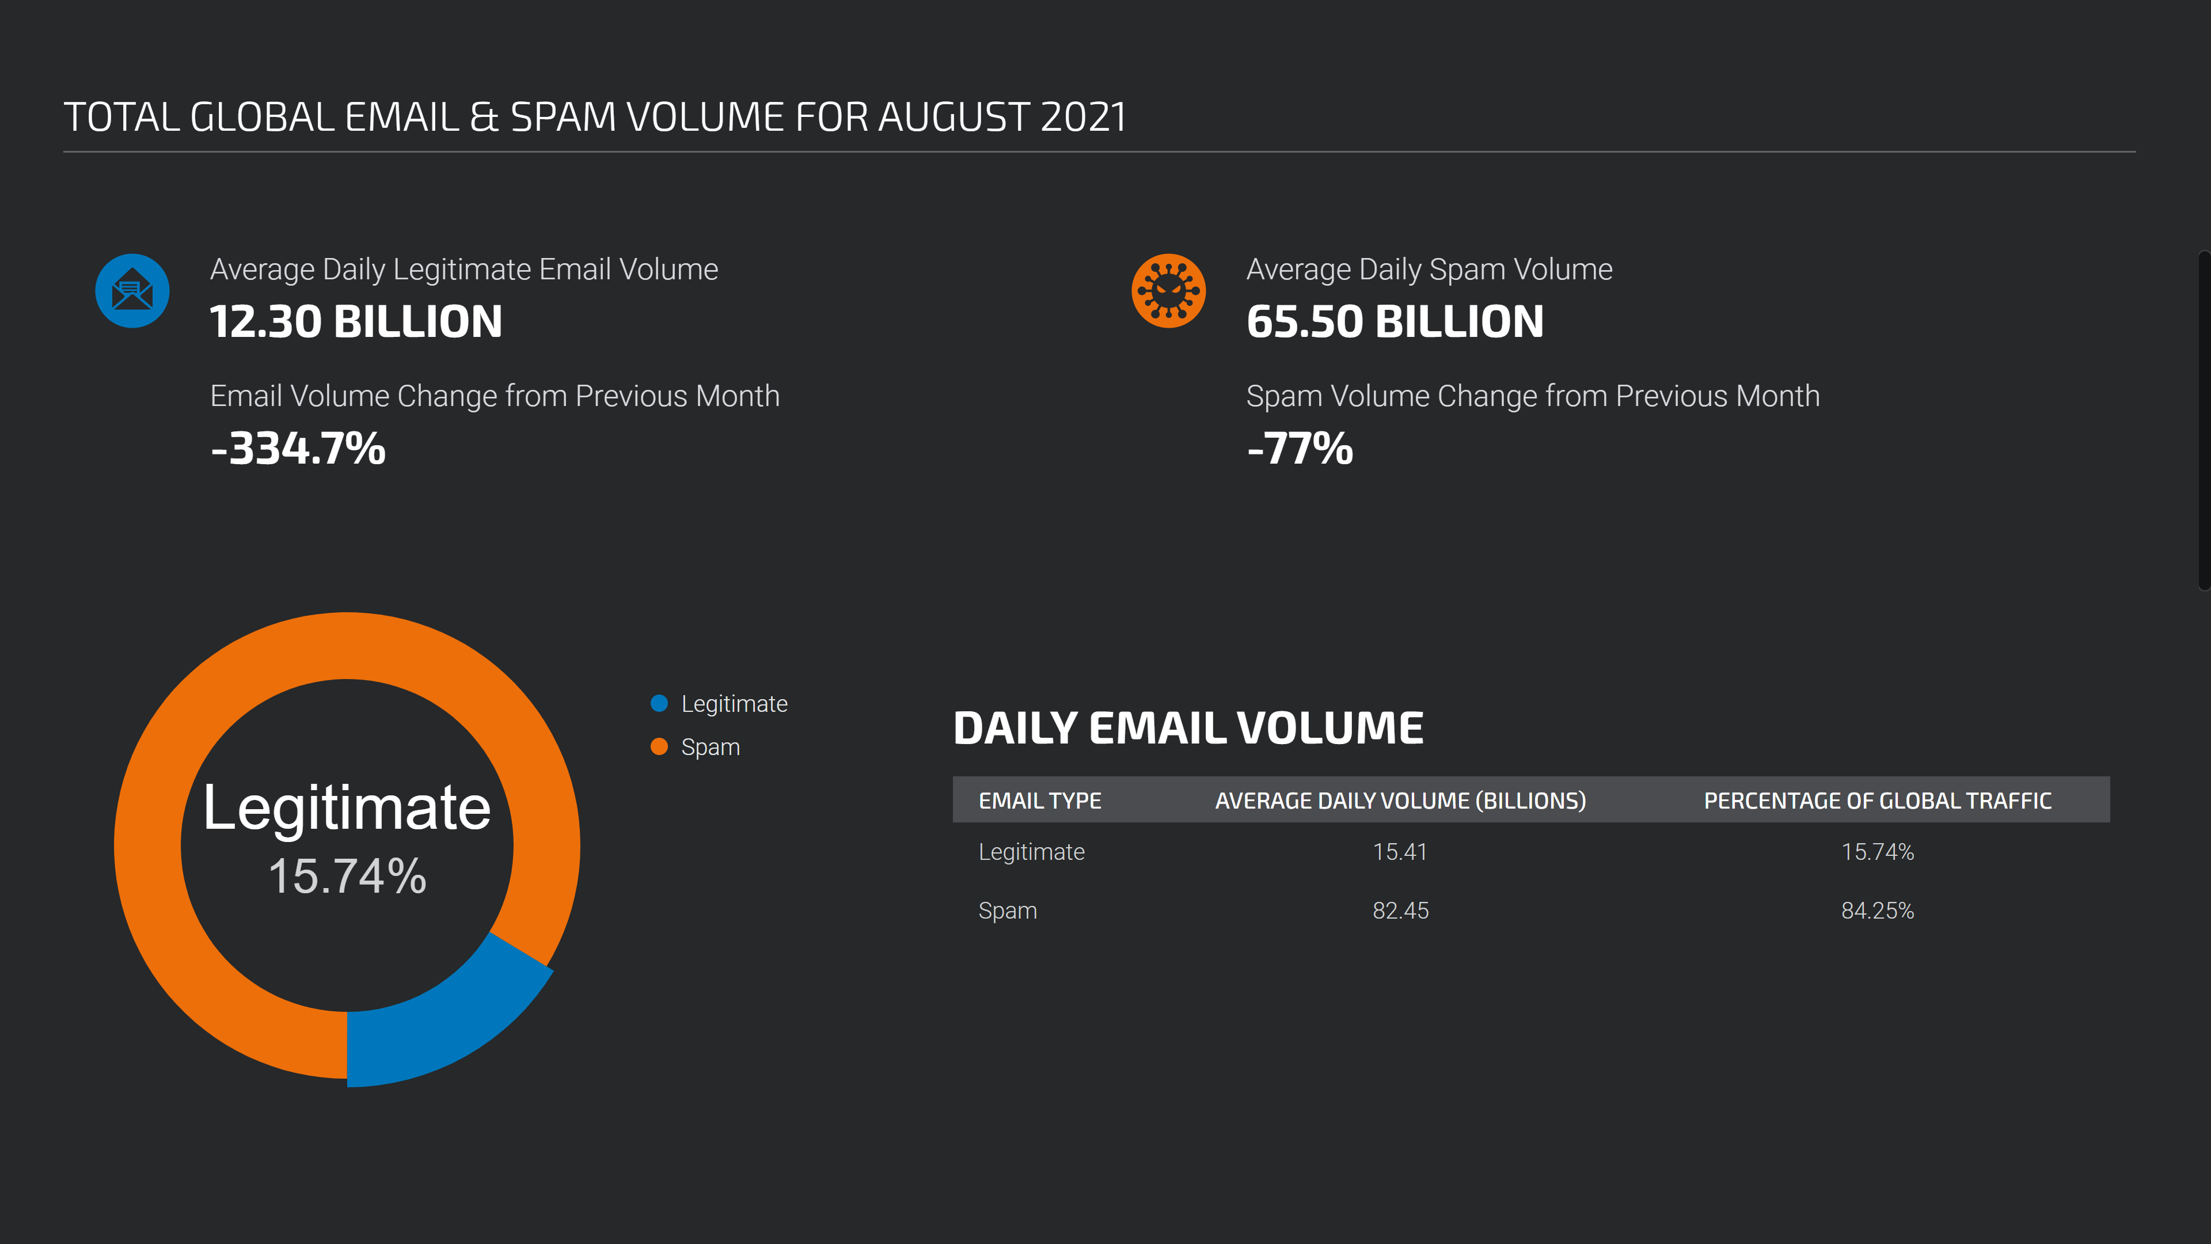
Notes:
Informing audience of the amount of SPAM vs genuine emails

Slide 13
Spotting SCAMS in email / SMS
Spoofed name.
Reply –to-spoof ( From name genuine)
Look-alike domain name (From address is close in appearance)
Spoofed Sender – No Reply to address
Check for “Reply-to” and “Return-path” parameters.
Sense of urgency /needs immediate action
Asks for sensitive information, (login info)
Includes link and induces you to click on it
Email / SMS is poorly written
Grammatical mistakes

Slide 14
Scammer’s Favourite Topics/Times
Urgent
Health
(COVID-19)
Orders & Delivery issues
Tax issues
Confidential
Seasonal Holidays
Notes:
In the past and in the future, scammers have used headline news in their attacks so you put your guard down. Throughout 2020, scammers used coronavirus themed attacks for phishing campaigns. Around the holidays, they will use cancelled orders or delayed deliveries because people are ordering gifts for loved ones. These tactics will *never* change.

Slide 15
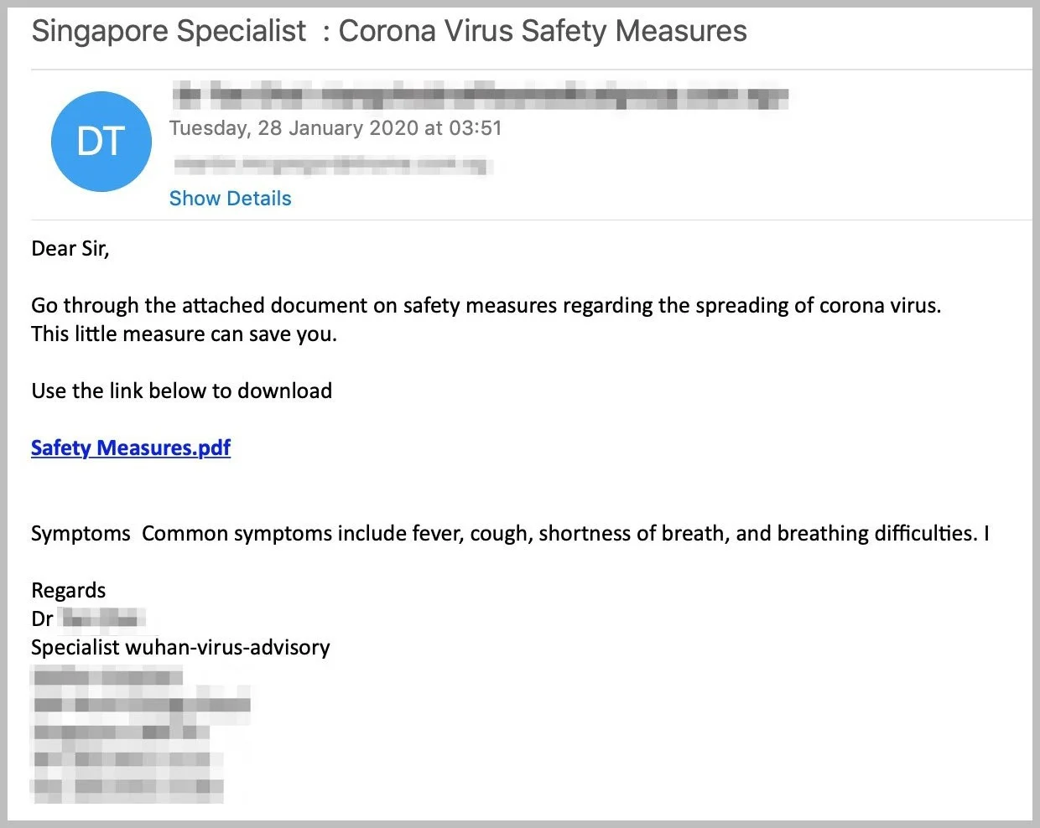
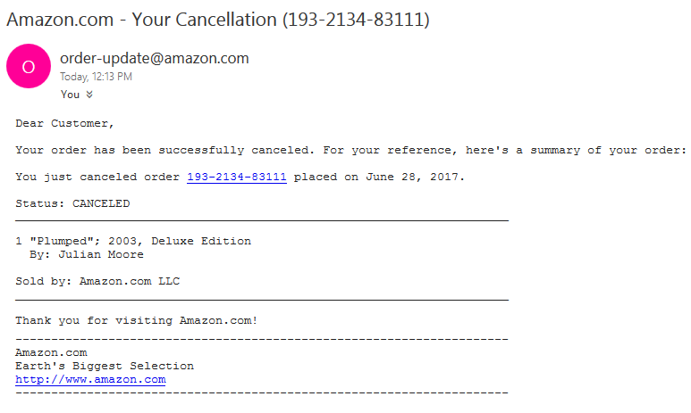
Scammer Favourites - Examples
Recent events – Covid-19
Order Cancelled
Notes:
These tactics will *never* change.

Slide 16
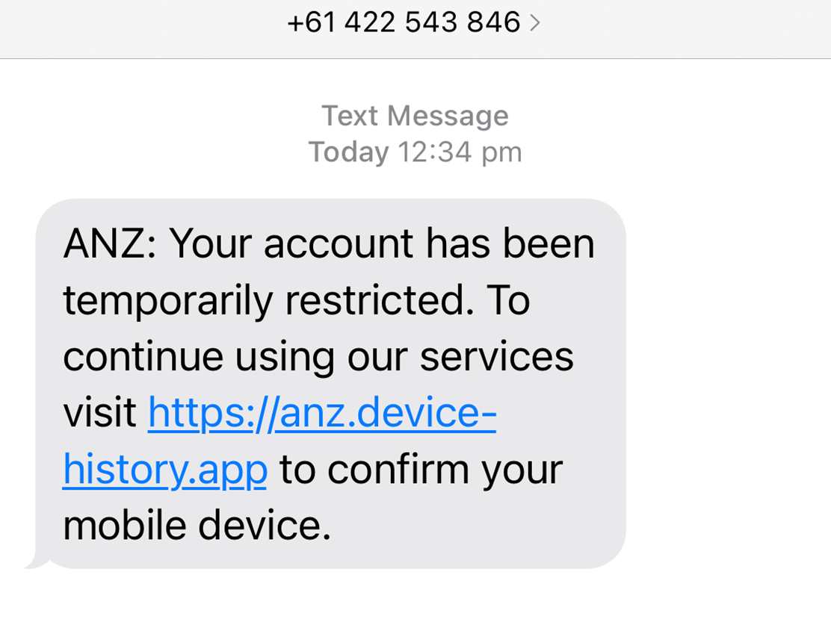
SMS SCAM Example (Smishing)
Panic : Account restriction!
Immediate action needed!
Source: CNN
Notes:
Links aren’t just email! This is an SMS text

Slide 17
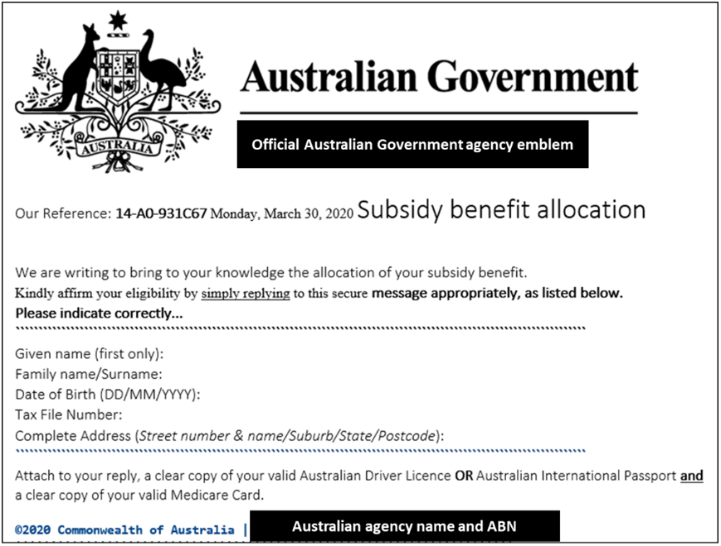
Poor grammar / English style
Asks for personal information

Slide 18
*Spot the Difference?*
*gtbank.com* is not the same as *gtbαnk.com*
*ecobank.com* is not the same as *ecobαnk.com*
(the first one is correct, the second one is from hackers)

Slide 19
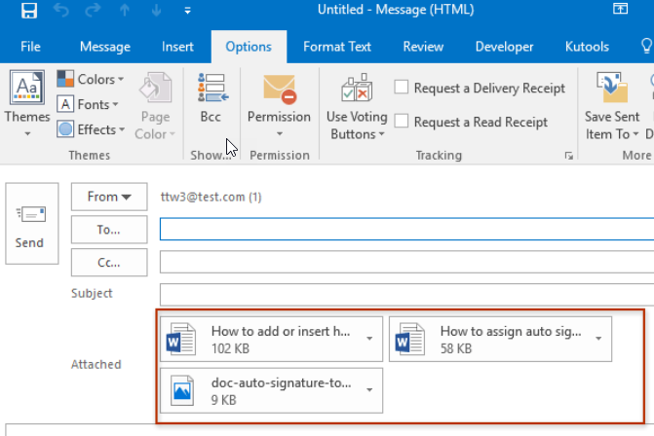
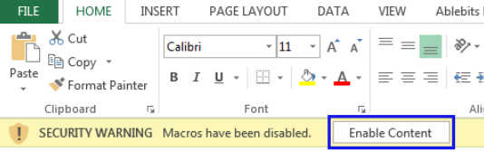
Email Attachments
Microsoft Outlook
Stop & think before you click!
Recognized sender?
Expecting attachment?
Is it normal for that contact to send attachments
Do not enable Macros
Enable Macros <- NOOOOOO!!!!
Notes:
Stop and think. Do you recognize the sender and do they normally email you attachments?
.doc and .dot make up 37% of malicious email attachments ( Symantec)

Slide 20
Be cautious of -
Freeware
Urgent / immediate requests
Attachments from unknown sources
( .zip .jar .exe)
Requests to check or confirm login details
Phone calls
from unknown sources
Order info you have never placed
Coupons with links
Pop ups

Slide 21
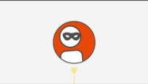
Notes:
Protecting yourself from Email payment fraud – Video from Combank

Slide 22
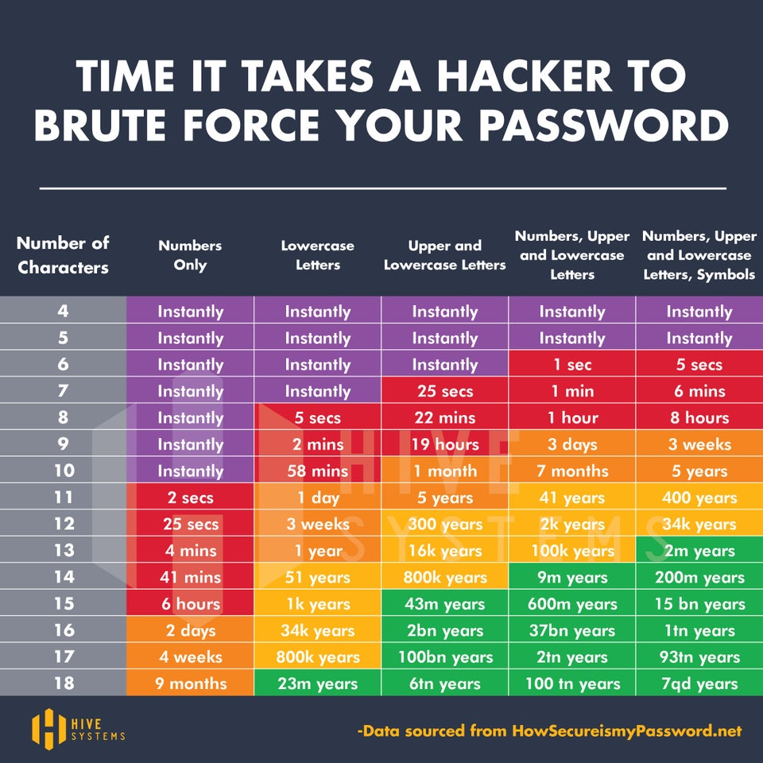
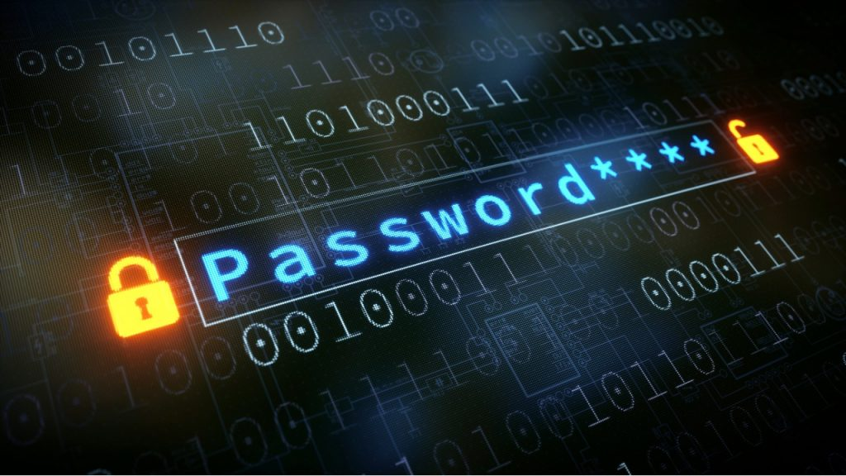
Password Strength
how long it takes to break passwords

Slide 23
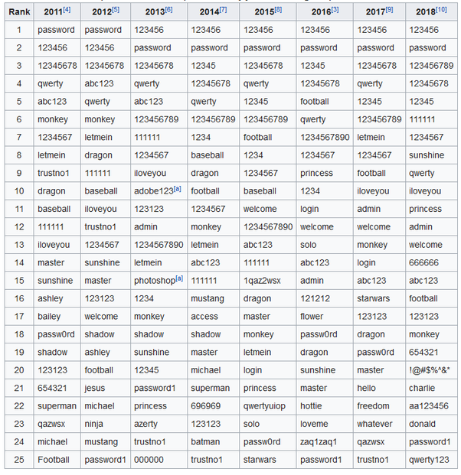
MOST COMMON
PASSWORDS
Change it if you see anything familiar

Slide 24
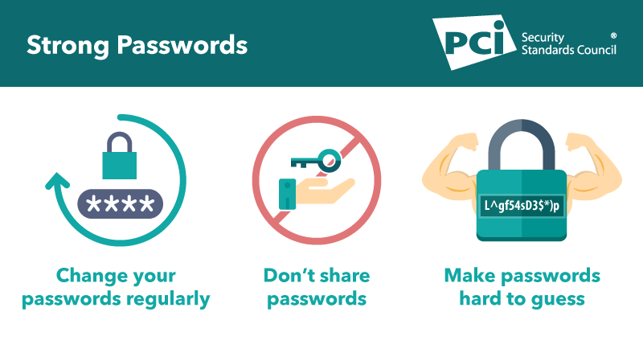
Passwords vs passphrases
Should not be easy to guess
  At least 12 characters, but 15 or more is far better
  Length is better than complexity (passphrases)
  Bad password (8): P@ssw0rd
  Great password (25): MysonwasbornNovember1995!!
  Password Managers
  Passwordless is the future
61%
9.6
6.1
0.2
Average number of lowercase letters
Average number of special characters
Passwords exactly 8 characters
Average Length of Password
Notes:
300 Billion passwords being used by human and machines ( Cybersecurity media)

Slide 25
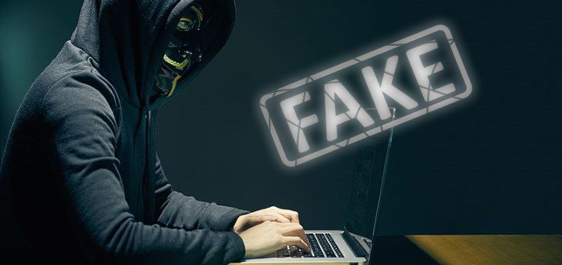
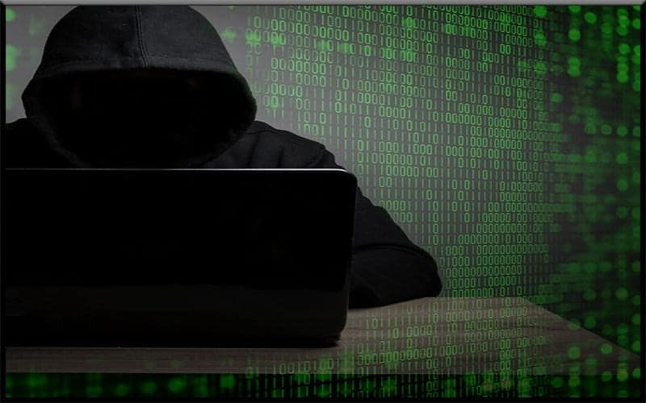
Internet Safety
Points of Vulnerability
Clicking on pop-ups
Installing anything based on a pop-up
Browser security- updates
Virus protection - on
Free software offers – do not click
Safe sites – don’t assume a “lock” is safe
Avoid public Wi-Fi hot spots ( Libraries, Cafes, Airports, Hotels etc)
Oversharing private information on social media

Slide 26
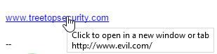
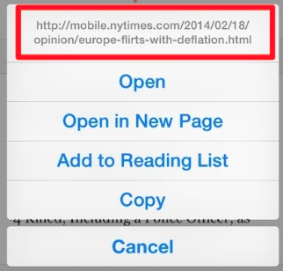
Hover before you click
Why hover?
  Blue text can be deceiving
  Underlying URL may be different
  Be aware of Foreign domains - .uk, .cn, .hu or .ru
Numbers instead of letters
  Example: 192.168.1.1 - Don’t trust it!
Hover on mobile/tablet? Long press (hold)
If in doubt? Don’t click it!!!
Desktop - Hover
Mobile - Long Press
http://www.evil.com/

Slide 27


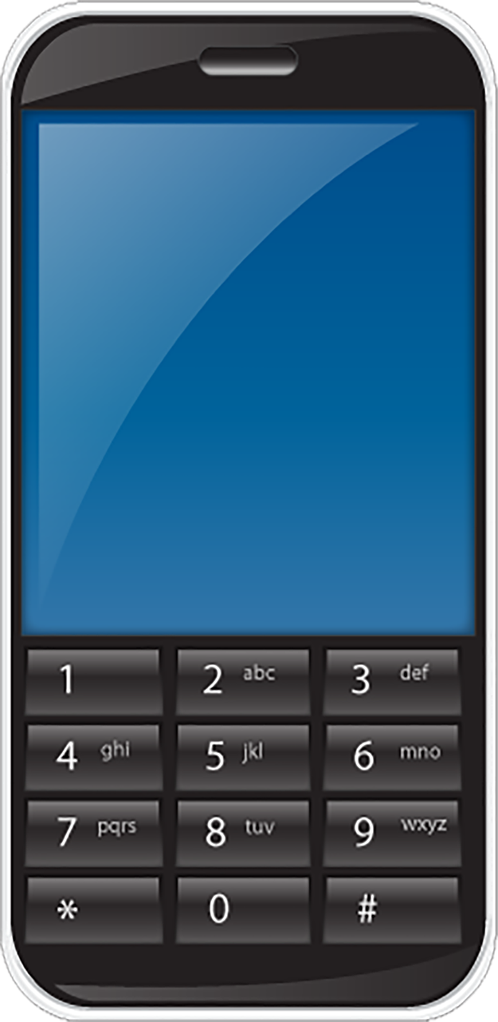

USB Drives & More
Do NOT connect unknown or unauthorized media (or devices)
Programs can run when plugged in without you doing anything
Examples
  USB/flash drives
  SD or micro SD cards
  CDs or DVDs
  External hard drives
  Cell phones <- Often forgotten
  High Risk Apps
Notes:
Keep in mind that it can infect your computer just by plugging it in.

Slide 28
Useful sites for Cybersecurity Awareness
https://haveibeenpwned.com/
Cyber Security Phishing Quiz – sample sites to check your maturity
https://phishingquiz.withgoogle.com/
https://www.cyber.gov.au/acsc/view-all-content/programs/stay-smart-online/scam-messages/quiz
https://www.ftc.gov/tips-advice/business-center/small-businesses/cybersecurity/quiz/phishing
https://www.ftc.gov/tips-advice/business-center/small-businesses/cybersecurity/quiz

Slide 29
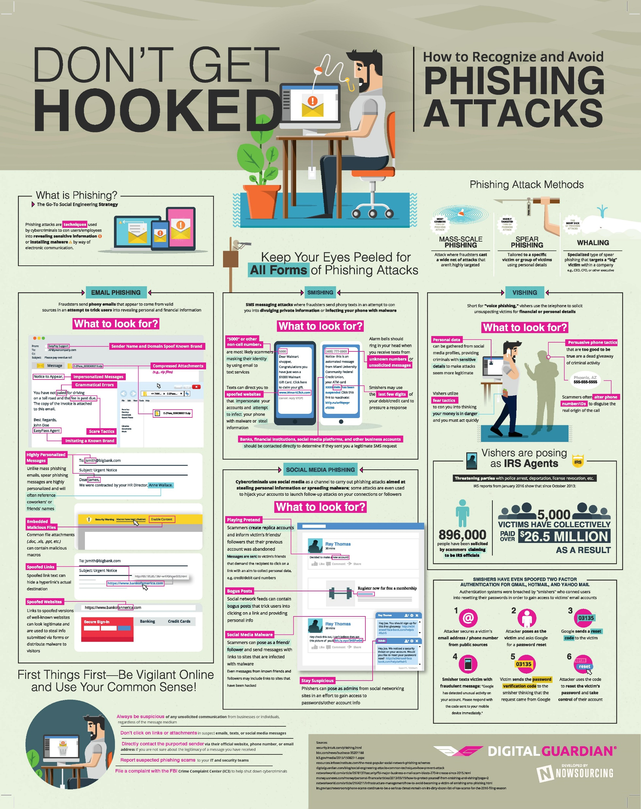
INFOGRAPHICS
https://info.digitalguardian.com/infographic-dont-get-hooked-recognize-and-avoid-phishing-attacks.html
https://www.cyber.gov.au/sites/default/files/2021-02/ACSC%20Small%20Business%20Cyber%20Security%20Guide.pdf

Slide 30
Cybersecurity Assessment Tool
https://digitaltools.business.gov.au/jfe/form/SV_cRMe9MTmaq6QmrA

Slide 31
Australia Essential Eight – A Brief overview
Defence against Cyber Threats
Application control
Patch applications
Configure Microsoft Office macro settings
User application hardening
Restrict administrative privileges
Patch operating systems
Multi-factor authentication and
Regular backups: The 3-2-1 Rule
Tools and Software? Leave it to the Cyber Security experts
https://www.cyber.gov.au/acsc/view-all-content/publications/essential-eight-maturity-model-faq

Slide 32
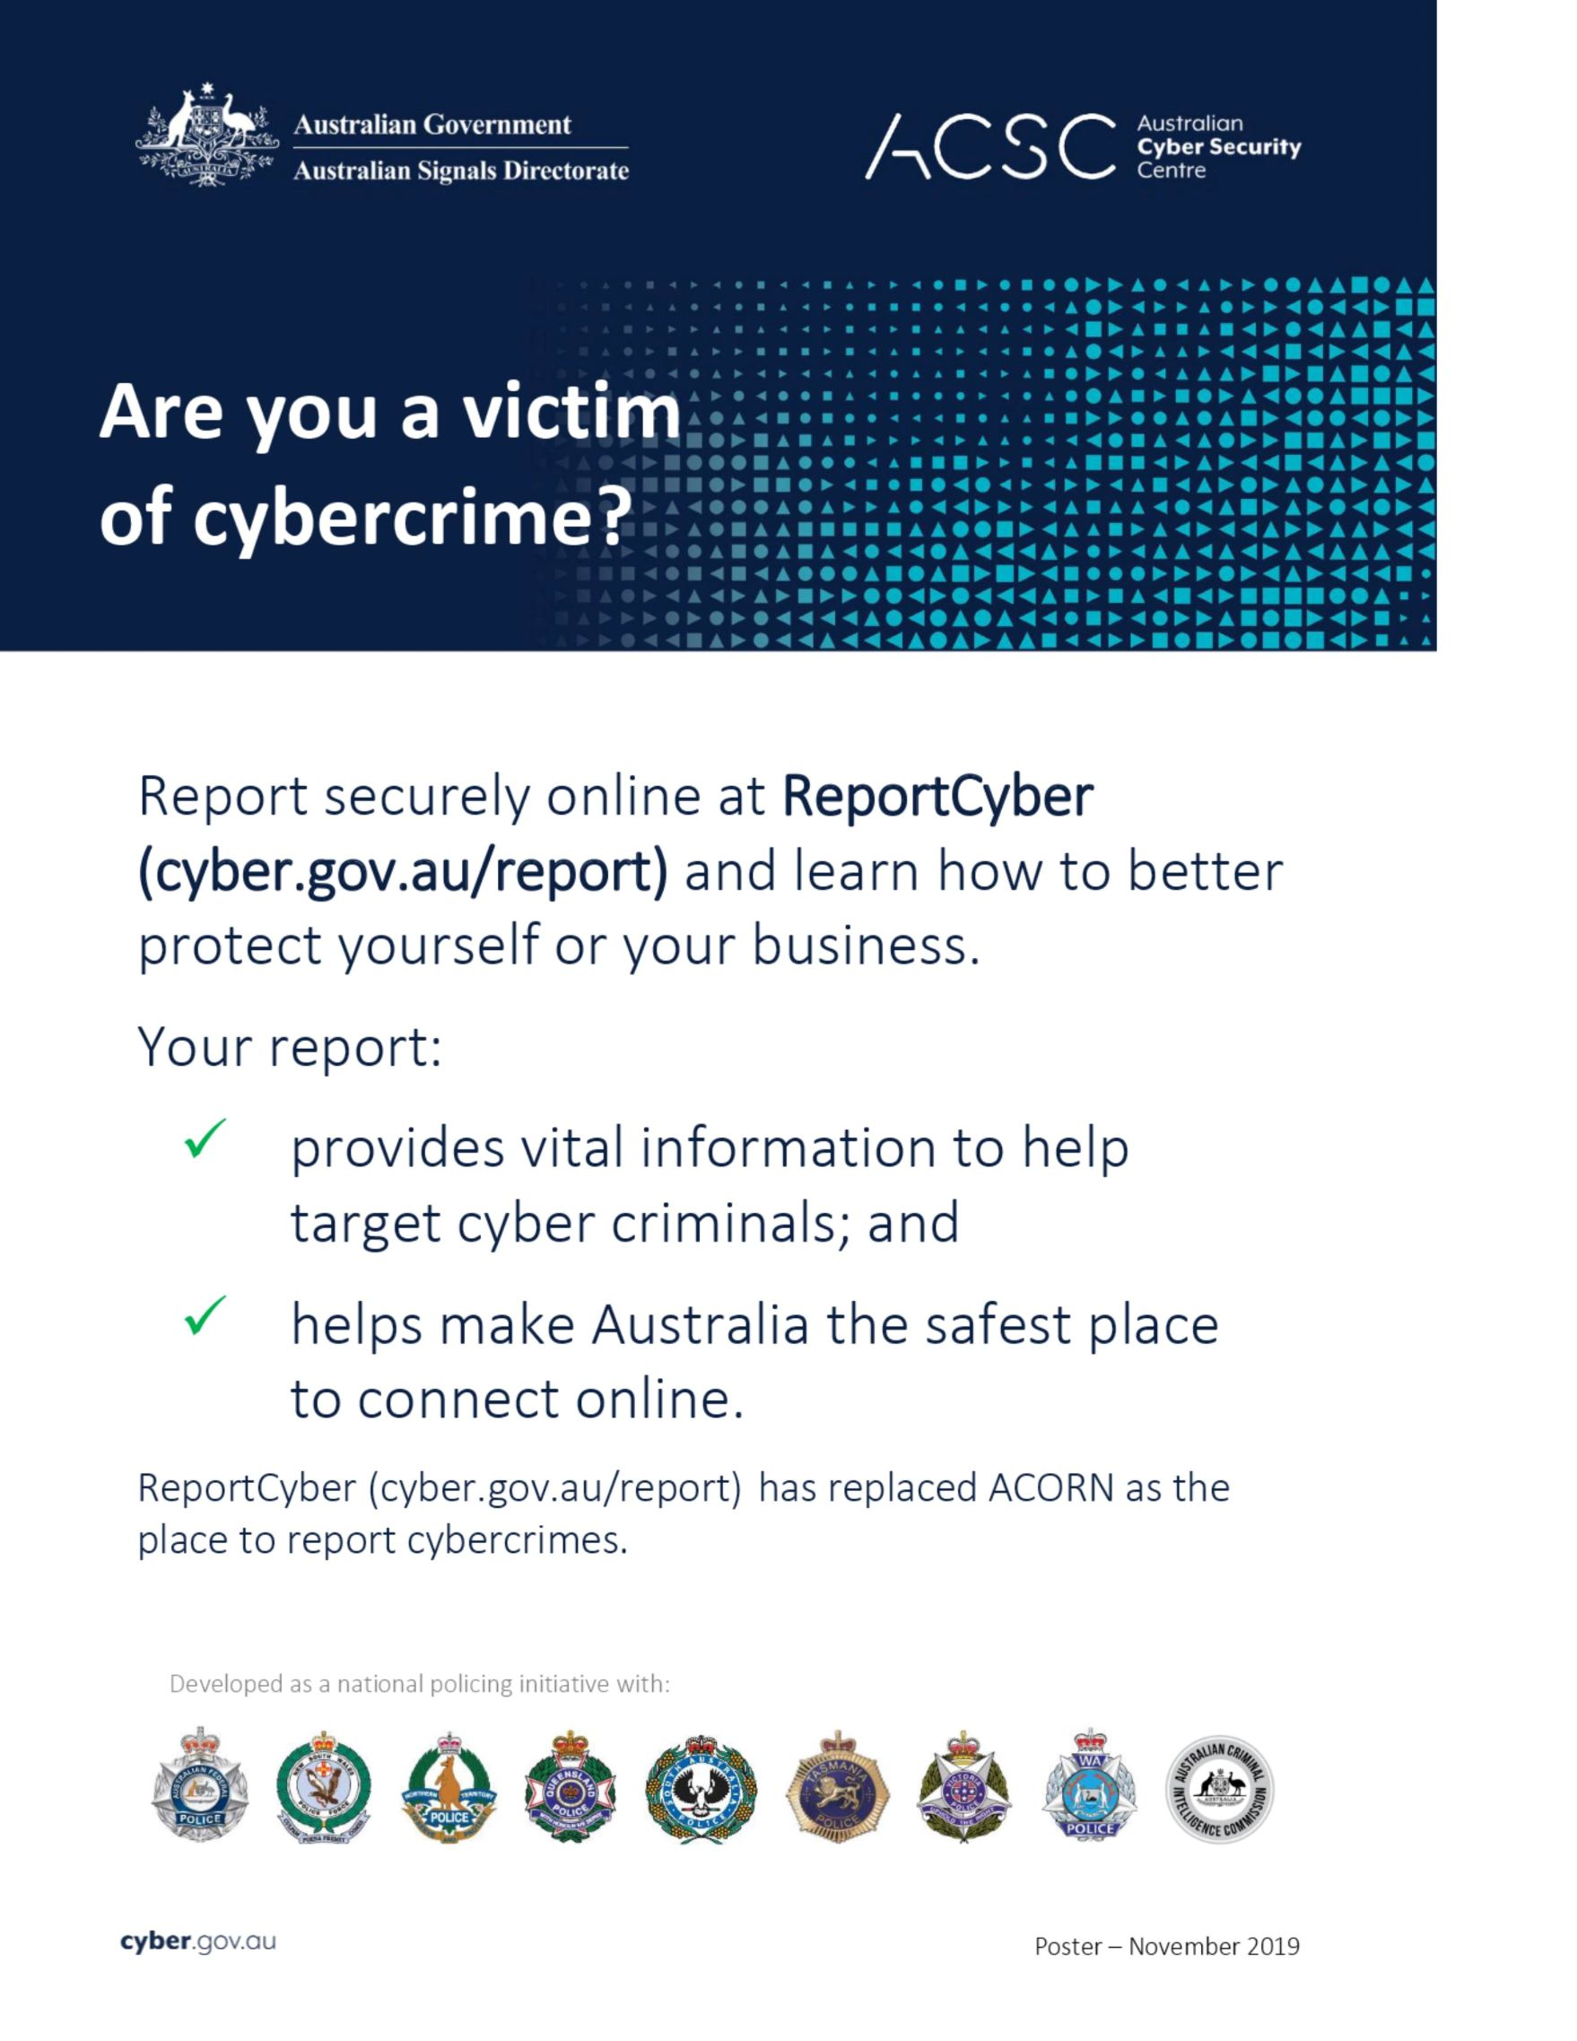
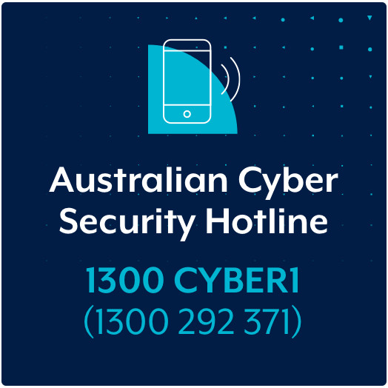
REPORT CYBERCRIME
https://www.cyber.gov.au/acsc/individuals-and-families
https://www.cyber.gov.au/acsc/small-and-medium-businesses

Slide 33
THANK YOU CITY OF CASEY!
Nayaz Noor - Director - Business Development
Jay Kunnangath - Director – Strategic Partnerships
Keylogix Pty Ltd is a
“Scam Awareness Week” partner
with ACCC during 08-12 NOV, 2021
The theme – “ Let’s talk Scams”
info@keylogix.com.au
Notes:
ACCC – Australian Competition & Consumer Commission

