Slide 1
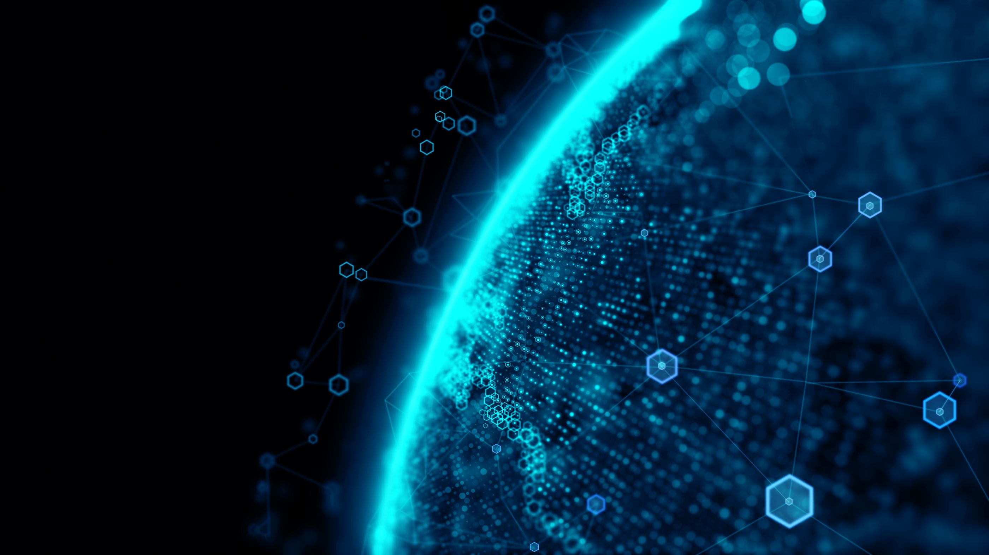
Blockchain
Blockchain defined:
Blockchain is a shared, immutable ledger that facilitates the process of recording transactions and tracking assets in a business network. An asset can be tangible (a house, car, cash, land) or intangible (intellectual property, patents, copyrights, branding). Virtually anything of value can be tracked and traded on a blockchain network, reducing risk and cutting costs for all involved.

Slide 2
BLOCKCHAIN
What is Blockchain?
Why blockchain is important: Business runs on information. The faster it’s received and the more accurate it is, the better. Blockchain is ideal for delivering that information because it provides immediate, shared and completely transparent information stored on an immutable ledger that can be accessed only by permissioned network members. A blockchain network can track orders, payments, accounts, production and much more. And because members share a single view of the truth, you can see all details of a transaction end-to-end, giving you greater confidence, as well as new efficiencies and opportunities.

Slide 3
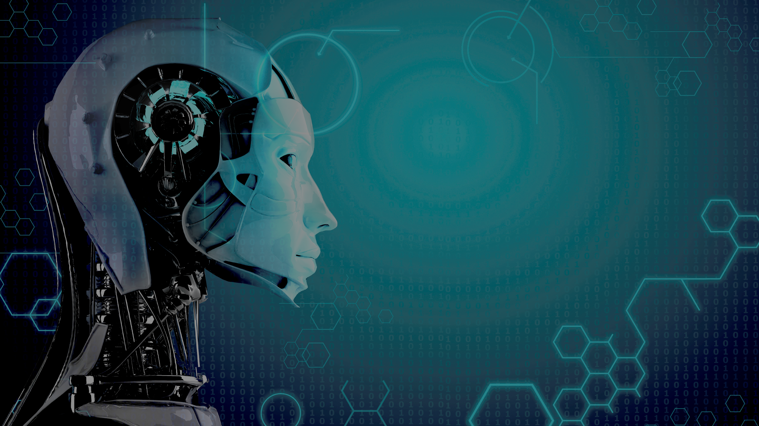
Machine Learning
Machine Learning defined:
Machine learning is an application of artificial intelligence (AI) that provides systems the ability to automatically learn and improve from experience without being explicitly programmed. The process of learning begins with observations or data, such as examples, direct experience, or instruction, in order to look for patterns in data and make better decisions in the future based on the examples that we provide. The primary aim is to allow the computers learn automatically without human intervention.

Slide 4
AI/MACHINE LEARNING
Why Machine Learning is important: Machine learning tools enable organizations to more quickly identify profitable opportunities and potential risks. The practical applications of machine learning drive business results which can dramatically affect a company’s bottom line. New techniques in the field are evolving rapidly and expanded the application of machine learning to nearly limitless possibilities. Industries that depend on vast quantities of data—and need a system to analyze it efficiently and accurately, have embraced machine learning as the best way to build models, strategize, and plan.

Slide 5
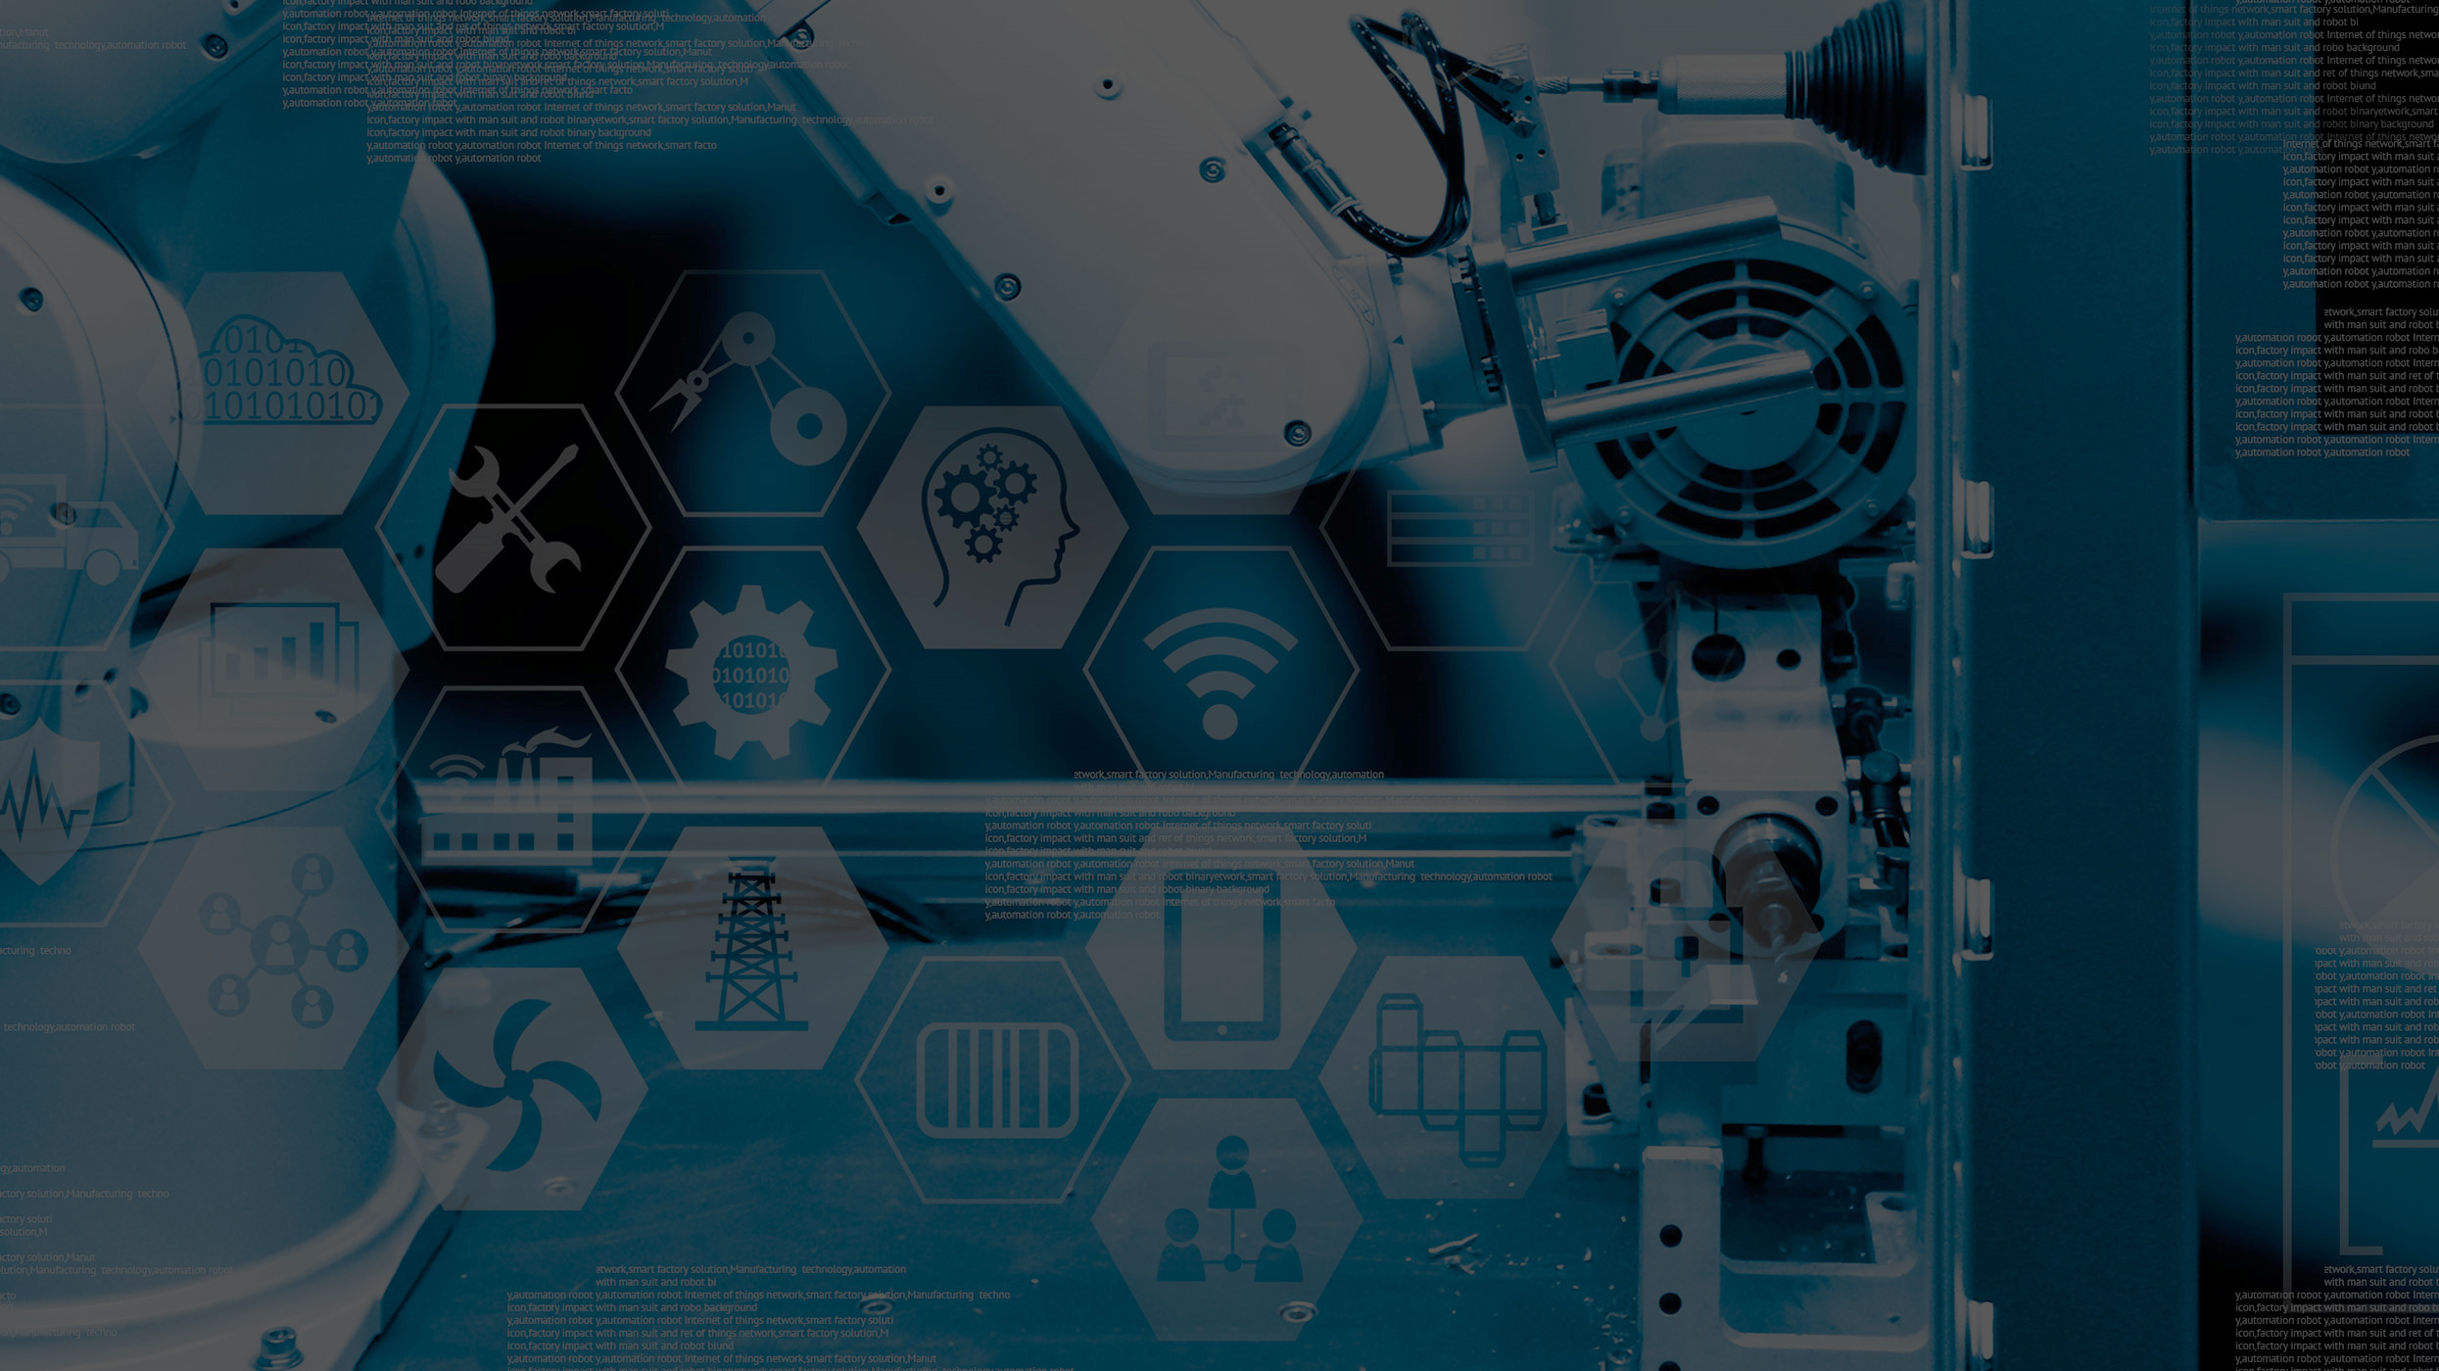
Industry 4.0
Industry 4.0 defined:
Industry 4.0 fundamentally changes the way in which businesses create and capture value. This shift is enabled by a set of technologies including autonomous robots, simulation technology, system integration, the Internet of Things (IoT), cybersecurity, cloud computing, additive manufacturing, augmented reality and big data. Industry 4.0 technologies have been around individually for a while, more recently, they have begun to mutually influence and impinge on each other, enabled by the Internet and a significant reduction in cost. This allows businesses to take advantage of the technology to significantly shift their business models.

Slide 6
INDUSTRY 4.0
Why Industry 4.0 is important: At a basic level, Industry 4.0 technologies add value by enabling better visibility into manufacturing lines, supply chains and resource usage. This increased visibility enables companies to increase productivity and to compete on values such as improved service. Complex cognitive skills such as programming and creative problem-solving will be in greater demand. ‘Soft’ social and intercultural skills, including collaboration, communication, consultation, and systemic and creative thinking, will also be increasingly vital, while basic physical, manual and cognitive skills are expected to decline.

Slide 7
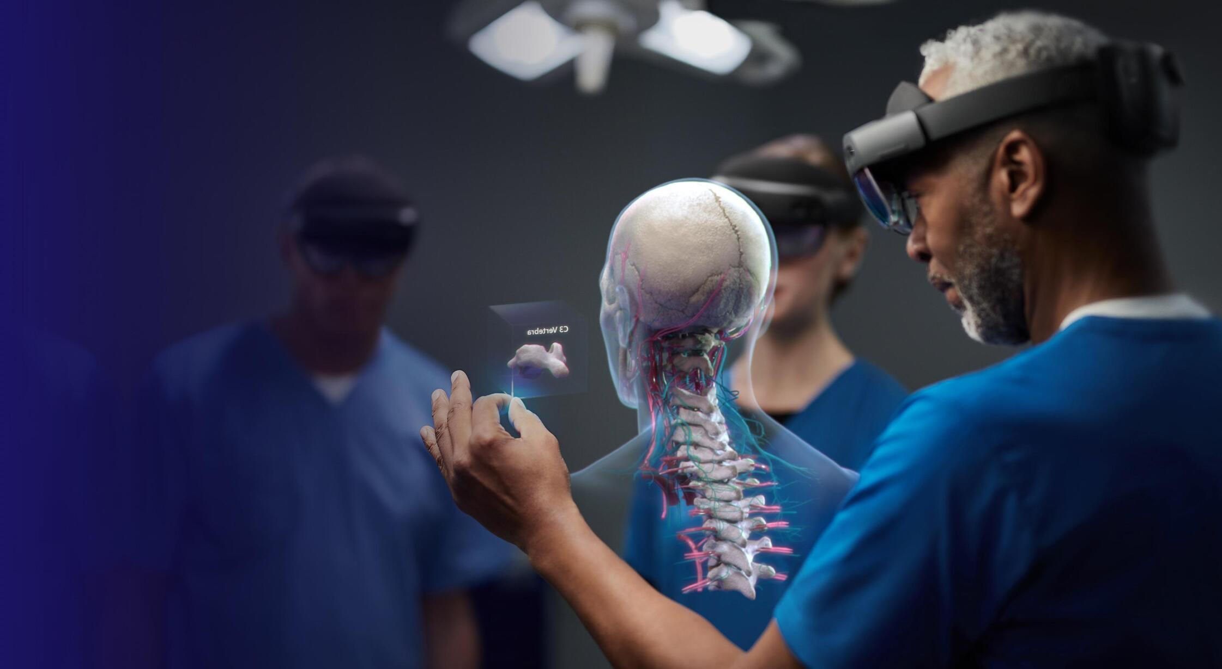
Mixed Reality
Mixed Reality defined:
Mixed Reality is a blend of physical and digital worlds, unlocking natural and intuitive 3D human, computer, and environment interactions. This new reality is based on advancements in computer vision, graphical processing, display technologies, input systems, and cloud computing.

Slide 8
MIXED REALITY
Why Mixed Reality is important: Adoption of augmented reality in business is expected to continue its rapid growth over the coming years with some analysts expecting the augmented reality market to reach over USD$198 billion by 2025, from its relatively modest USD$3.5 billion in 2017. Businesses everywhere are looking to capitalise on AR/MR opportunities to virally market their products in unique and noticeable ways. Retail, education and travel and tourism are just some of the markets this technology is paving its way into. One of the key benefits of virtual reality is the ability to provide simulated training for high-risk tasks, particularly those in the fields of healthcare, manufacturing and energy. When it comes to the future of work, one of the simplest, but most powerful applications for mixed reality is collaboration.

